Slide 1
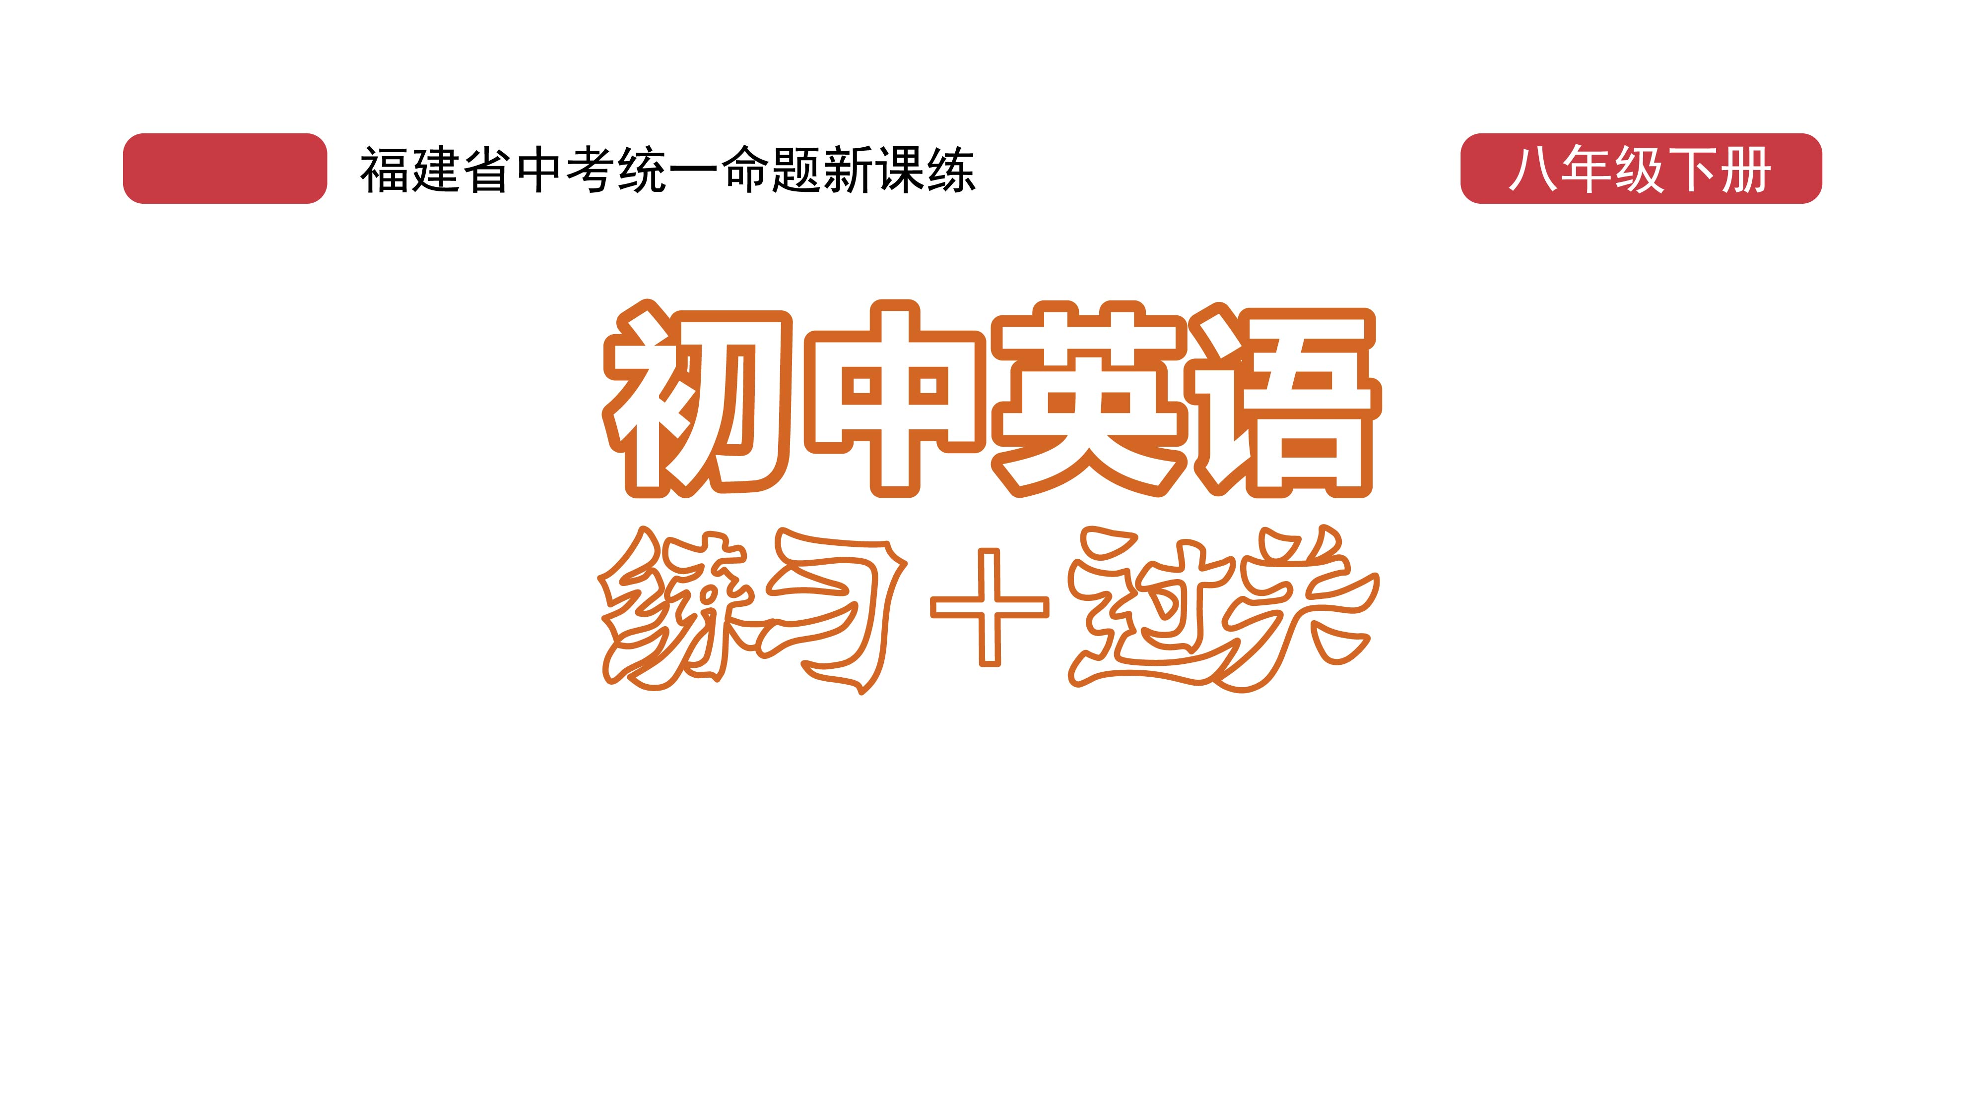
课时练习
模块八 第二章 读写综合训练

Slide 2
一、完形填空。
A Swedish couple(夫妻) on holiday were traveling around Italy, and wanted to go to Capri. Capri is an island(岛) in the south of the country, 1__ for its beautiful coastline and a popular tourist destination(目的地). The couple put their destination into their car’s GPS, 2 they made a spelling mistake. 1. A. suitable B. useful C. famous 2. A. and B. so C. but
C
C

Slide 3
一、完形填空。
B
They 3 typed “Carpi” instead of “Capri”. There is a real place called Carpi in Italy, but it is a small town in the 4 of the country.
The couple followed the GPS directions. Although they were traveling to an island, it didn’t 5 them that they didn’t even cross a bridge
3. A. slowly B. carelessly C. correctly
4. A. south B. east C. west
5. A. relax B. worry C. touch
A
B

Slide 4
一、完形填空。
or see the sea. When they arrived in Carpi, they went to the tourist office. They asked 6 they could go to the Blue Grotto, a well-known sea cave(海蚀洞) in Capri. Of course, the office worker there couldn’t 7 them. He thought the couple wanted to go to a 8__ called the Blue Grotto for dinner.
6. A. But B. However C. Though
7. A. refuse B. interview C. understand
8. A. museum B. restaurant C. airport
A
C
B

Slide 5
一、完形填空。
When the man realized that the couple thought they were in Capri, he 9 their mistake. Then the couple got back into their car and kept driving south. They were 10 , but not angry.
9. A. accepted B. corrected C. discussed
10. A. problem B. question C. reason
B
C

Slide 6
二、阅读理解。
Many people like to shop for clothes. But do you know how to buy clothes? Here are some suggestions for you.
First, when you want to go shopping, decide how much money you can spend on new clothes. Think about the kind of clothes you really need, and then look for them.

Slide 7
二、阅读理解。
Second, there are labels(标签) inside all new clothes. The labels tell you how to take care of the clothes. For example, the label for a shirt may tell you to wash it in warm water. A sweater label may tell you to wash it in cold water. The label on a coat may say “dry clean only”, for washing may ruin(毁坏) this coat.

Slide 8
二、阅读理解。
Third, many clothes today must be drycleaned. Dry cleaning is expensive. When buying new clothes, check to see if they will need to be dry-cleaned. You will save money if you buy clothes that can be washed.

Slide 9
二、阅读理解。
Fourth, you can save money if you buy clothes that are well made. Well-made clothes last longer. They still look good even after being washed many times. Clothes that cost more money may not be better made. They do not always fit well. Sometimes less expensive clothes look and fit better than more expensive ones.

Slide 10
二、阅读理解。
( )1. How many pieces of advice does the writer give on buying clothes?
A. Two. B. Three. C. Four. D. Five.
C

Slide 11
二、阅读理解。
( )2. The first thing for you to do before you buy clothes is to _____.
A. know how to wash them
B. see how much money you can spend
C. look for well-made clothes
D. read the labels inside the clothes
B

Slide 12
二、阅读理解。
( )3. The labels inside the clothes tell you ____.
A. how to buy clothes
B. how to save money
C. how to wash the clothes
D. whether they fit you or not
C

Slide 13
二、阅读理解。
( )4. According to the text, which of the following is NOT true?
A. Expensive clothes must be better made.
B. You may pay more if you buy clothes that must be dry-cleaned.
C. Clothes that can be washed will save you money.
D. Clothes that are well made can be less expensive.
A

Slide 14
二、阅读理解。
( )5. We learn from the text that cheaper clothes____.
A. have no labels B. are not washable
C. don’t look good D. sometimes fit you better
D

Slide 15
三、短文填空。
Nowadays, more and more schools in China ask students to wear school uniforms to school. Parents and 1 (teach) think it will create a better learning 2 /ɪnˈvaɪrənmənt/ at school, but some students don’t like their school uniforms. They want to make their own uniforms like students in other countries do. So, 3 are school uniforms like in other parts of the world?
teachers
environment
what

Slide 16
三、短文填空。
In Japan, boys in middle school wear uniforms called “gakuran”, which have dark jackets with stand-up collars(立领) and pants. Girls, on the 4 hand, wear uniforms called “sailorfuku” which look like European naval(海军的) uniforms.
other

Slide 17
三、短文填空。
Most schools in England require(要求) students to wear school uniforms. Boys need to wear long grey or black pants, white shirts and school ties. Girls have the same clothes 5 boys, but they can wear skirts or summer school 6 (dress) during the summer term. In the UK, wearing uniforms 7 (be) the custom(习俗) throughout most of the 20th century, but now more and more 8 /ˈpʌblɪk/ schools stop
as
dresses
was
public

Slide 18
三、短文填空。
requiring students to do so. They think uniforms make students 9 /luːz/ their personalities(个性).
In a word, love it or not, the school uniform is part of 10 (grow) up for children around the world, so you should try to enjoy your school uniforms and your school life.
lose
growing

Slide 19
四、书面表达。
假如你是Linda, 你们班要举行 “How to dress correctly” 的主题班会。请你根据以下思维导图提示, 写一篇不少于80词的英语演讲稿。(开头和结尾已给出， 不计入总词数)

Slide 20
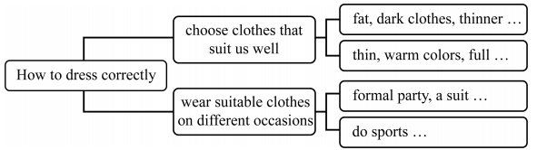
四、书面表达。

Slide 21
四、书面表达。
Hello, everyone. I’m Linda. I’m glad to have the chance to share my ideas about how to dress correctly. First,
we should choose clothes that suit us well. If we are fat, we should wear darkcolored clothes. Dark colors make people look thinner. If we are very thin, we should wear clothes in warm colors, because they make us look full.

Slide 22
四、书面表达。
Second, we should wear suitable clothes on different occasions. If we go to a formal party, it’s best to wear a suit or a dress. When we do sports, it’s necessary for us to wear sportswear and sports shoes. In a word, it’s important for us to dress correctly.
That’s all. Thank you.

Slide 23
